Slide 1
Final Project # 1
Social media analysis
Dec 4, 2023
Dollaya Hirunyasiri, Skylar Li, Angela Yang, Juan Puentes, Qingyuan Zheng

Slide 2
Agenda
01
The context
02
Data Preparation
- Background
- Target group
- Data set
- Problem statement
- Data Preparation in general
- Modelling methods
- Modelling method for Praises and Complaints
03
Questions about customers
04
Questions about the two brands
1. What are customers expectation?
2. What are customer knowledge gap?
3. What are the general sentiments of the customers of Dexcom and Freestyle Libre?
4. What are the praises and complaints of these two brands?
5. What are the recommendations?

Slide 3
PART 1
The Context

Slide 4
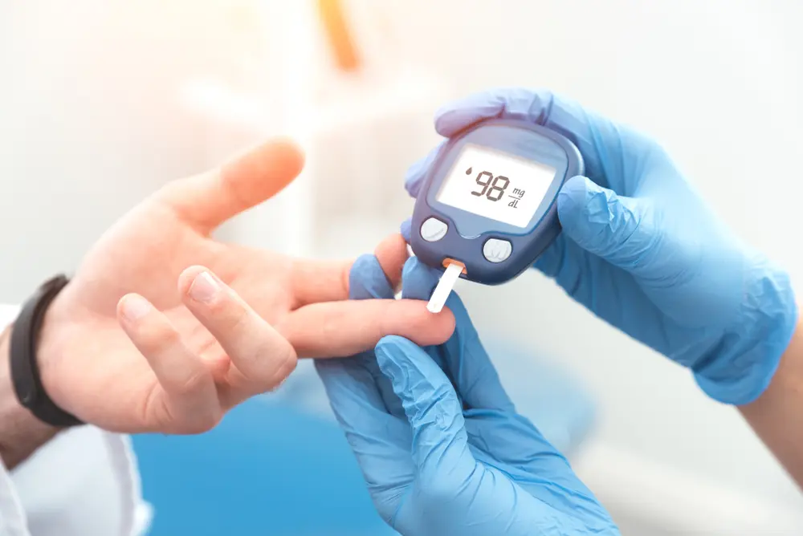
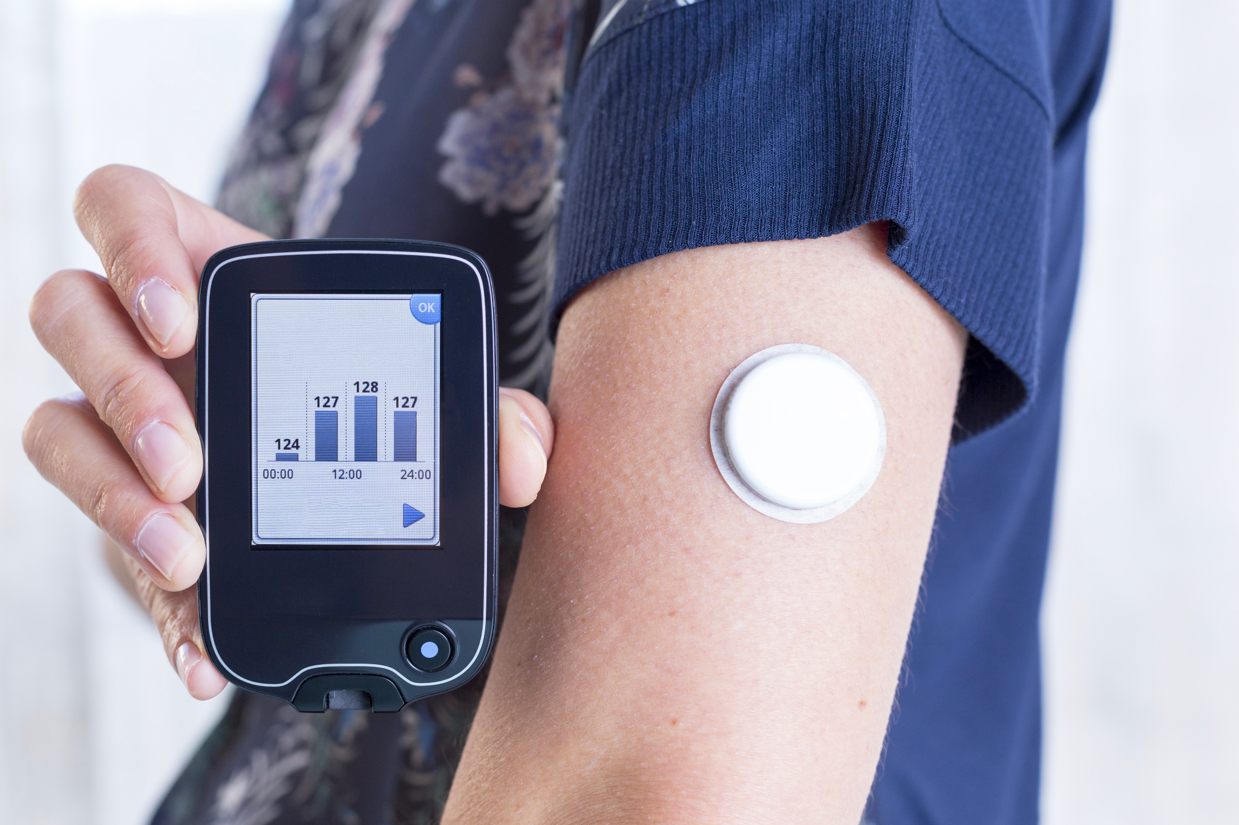
Background
Managing blood sugar levels is crucial for diabetic patients due to the potential health risks of fluctuations. Continuous Glucose Monitoring (CGM) systems offer a significant advancement by continuously tracking glucose levels, ensuring they stay within a safe range.
Notes:
Rephrase it) patients
juan

Slide 5
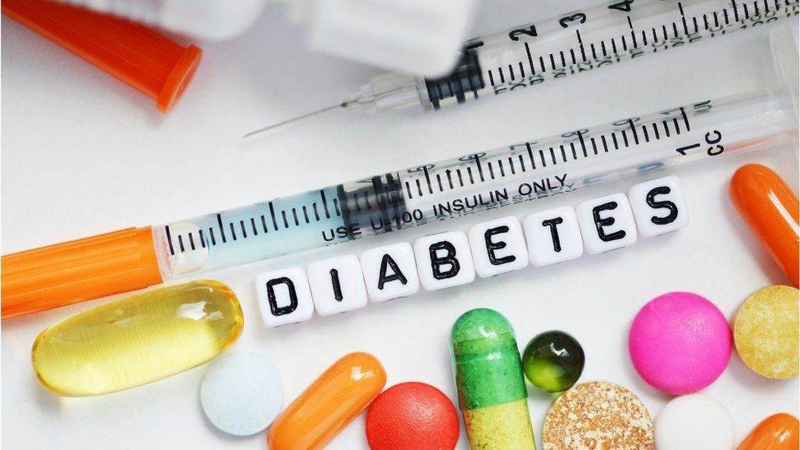
Target Group
Individuals with Type 1 Diabetes Interested in Continuous Glucose Monitoring.

Slide 6


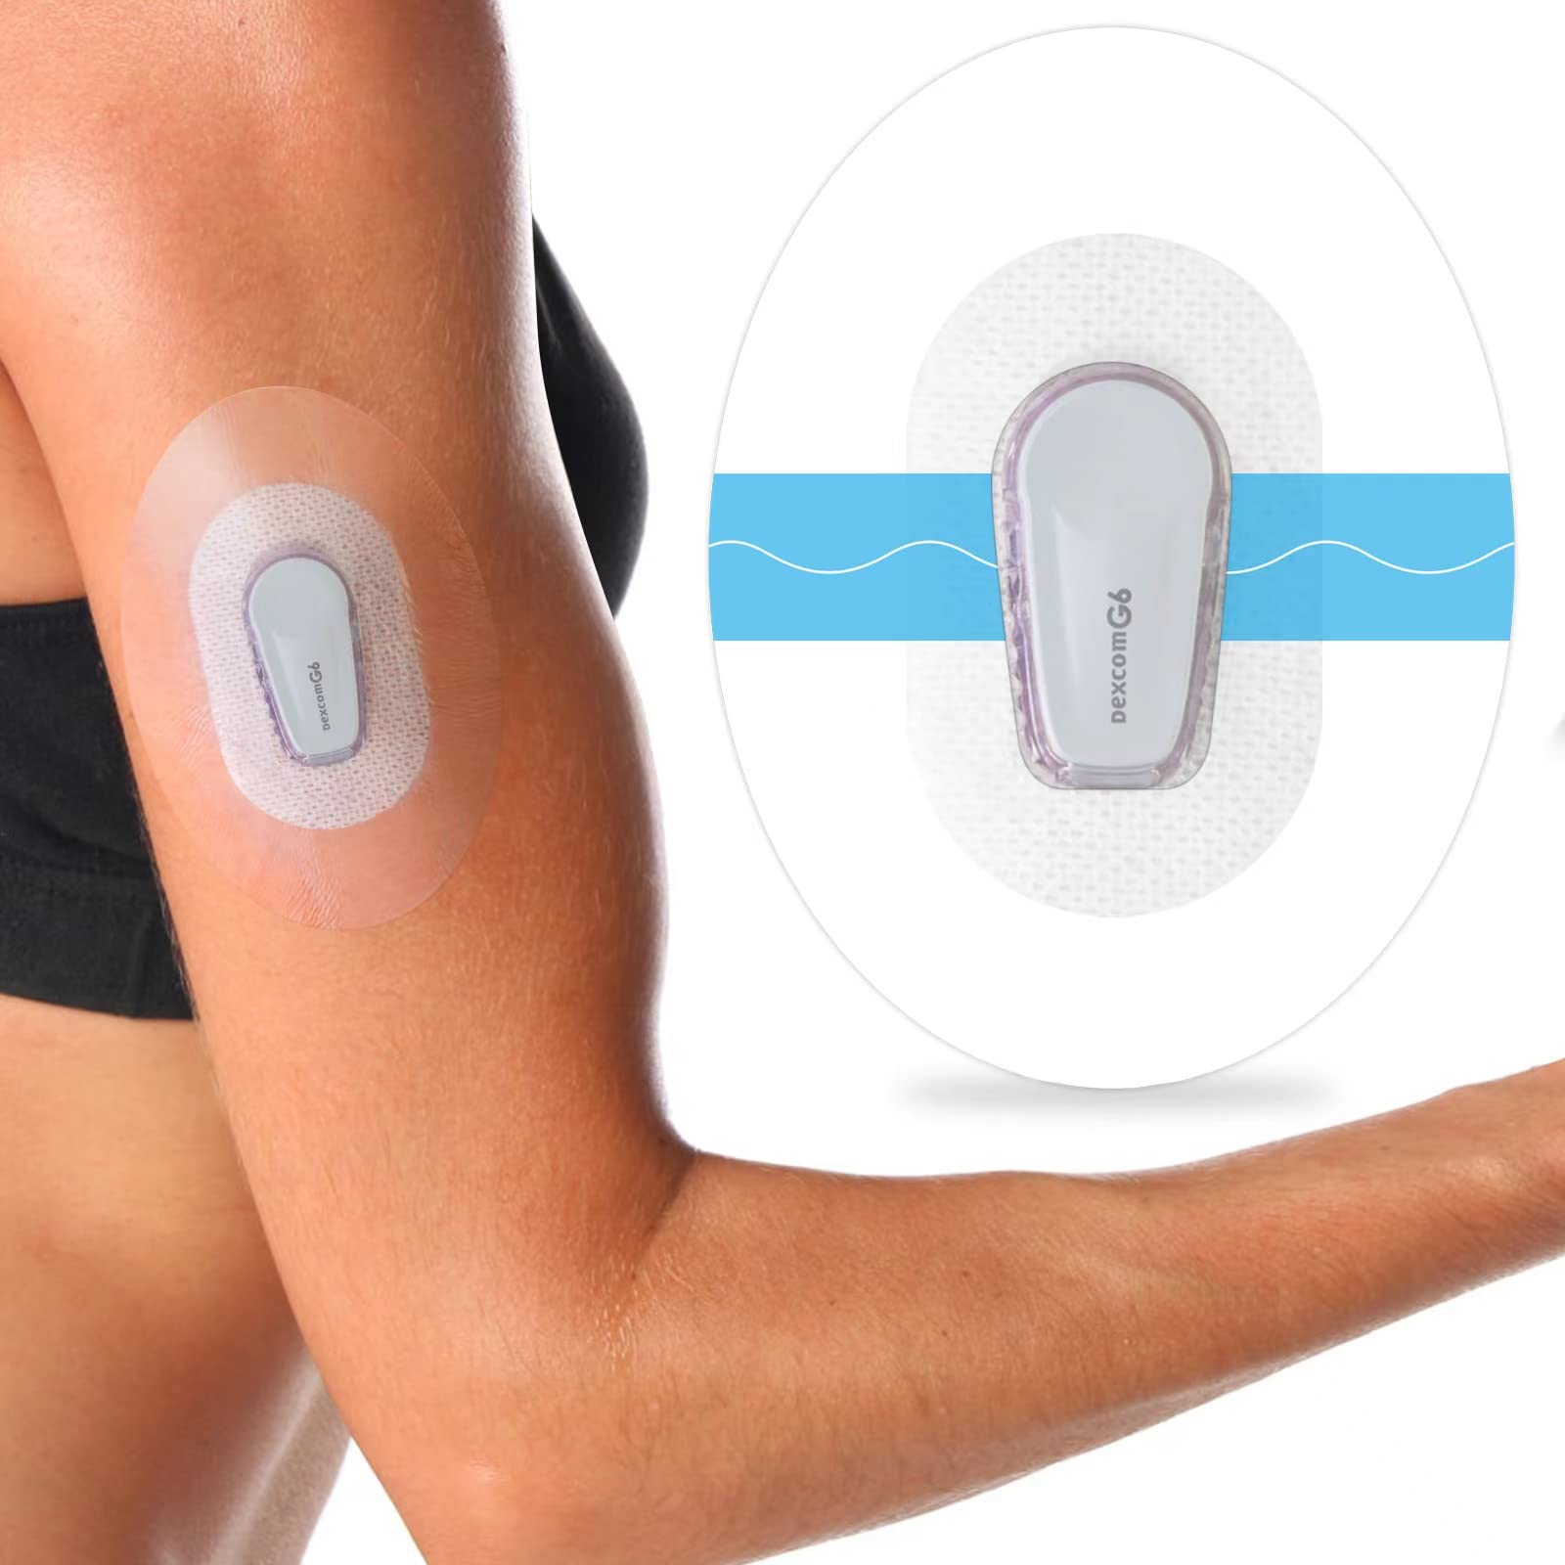
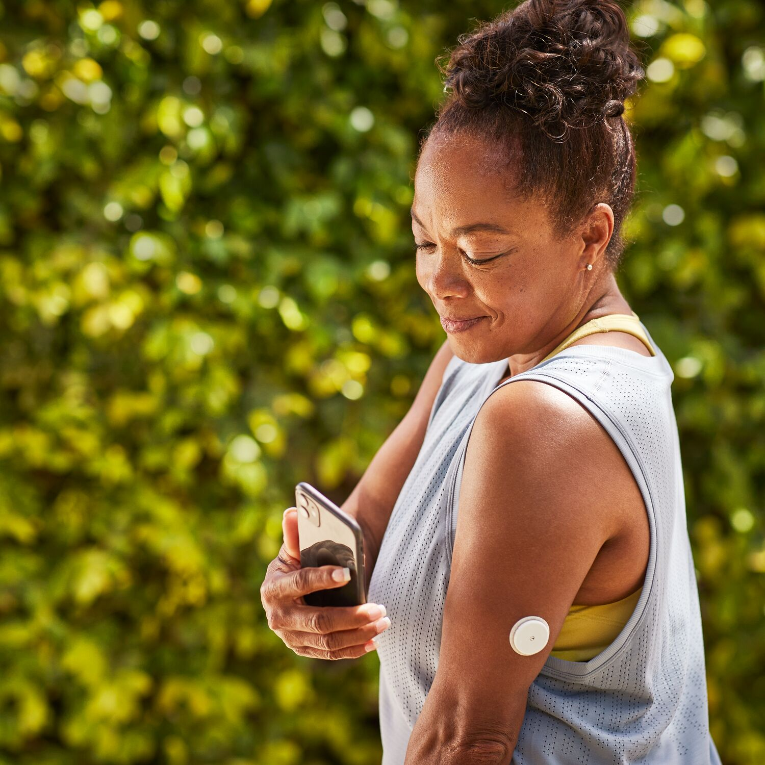
Two main Continuous Glucose Monitoring brands customers discuss
Notes:
https://www.adces.org/danatech/glucose-monitoring/continuous-glucose-monitors-(cgm)/cgm-selection-training/dexcom-g7-libre-3-comparison

Slide 7

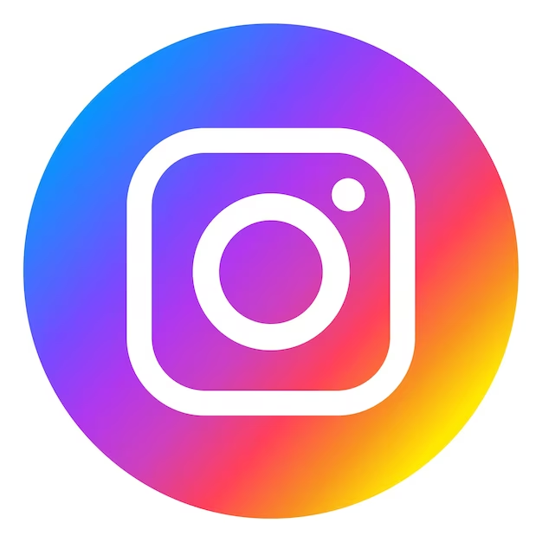


Dataset
Size: 37K social media posts on CGM and 63 variables
Text content of posts and Title as the main content variables to evaluate
Source: a variety of platforms:
Timeline: 2021-2022
Notes:
juan

Slide 8
Questions to be answered
Customers
What are customers expectation?
What are customer knowledge gap?
Brand
What are the general sentiments of the customers of Dexcom and Freestyle Libre?
What are the praises and complaints of these two brands?
What are the recommendations?

Slide 9
PART 2
Data Preparation

Slide 10
Data Preparation - General
Cleaning
Remove punctuation, frequent words, lower case
Stemming & Lemmatization
base or root form
morphological analysis also for base words form
N-grams
Divide sentence elements
EDA
Basically statistical features

Slide 11
Modeling Methods
Purpose | Method Name
Keywords | Topic Modeling TextBlob
Product Features | Pos Tagging
Customers’ Praises and Complaints | Logistic Regression

Slide 12
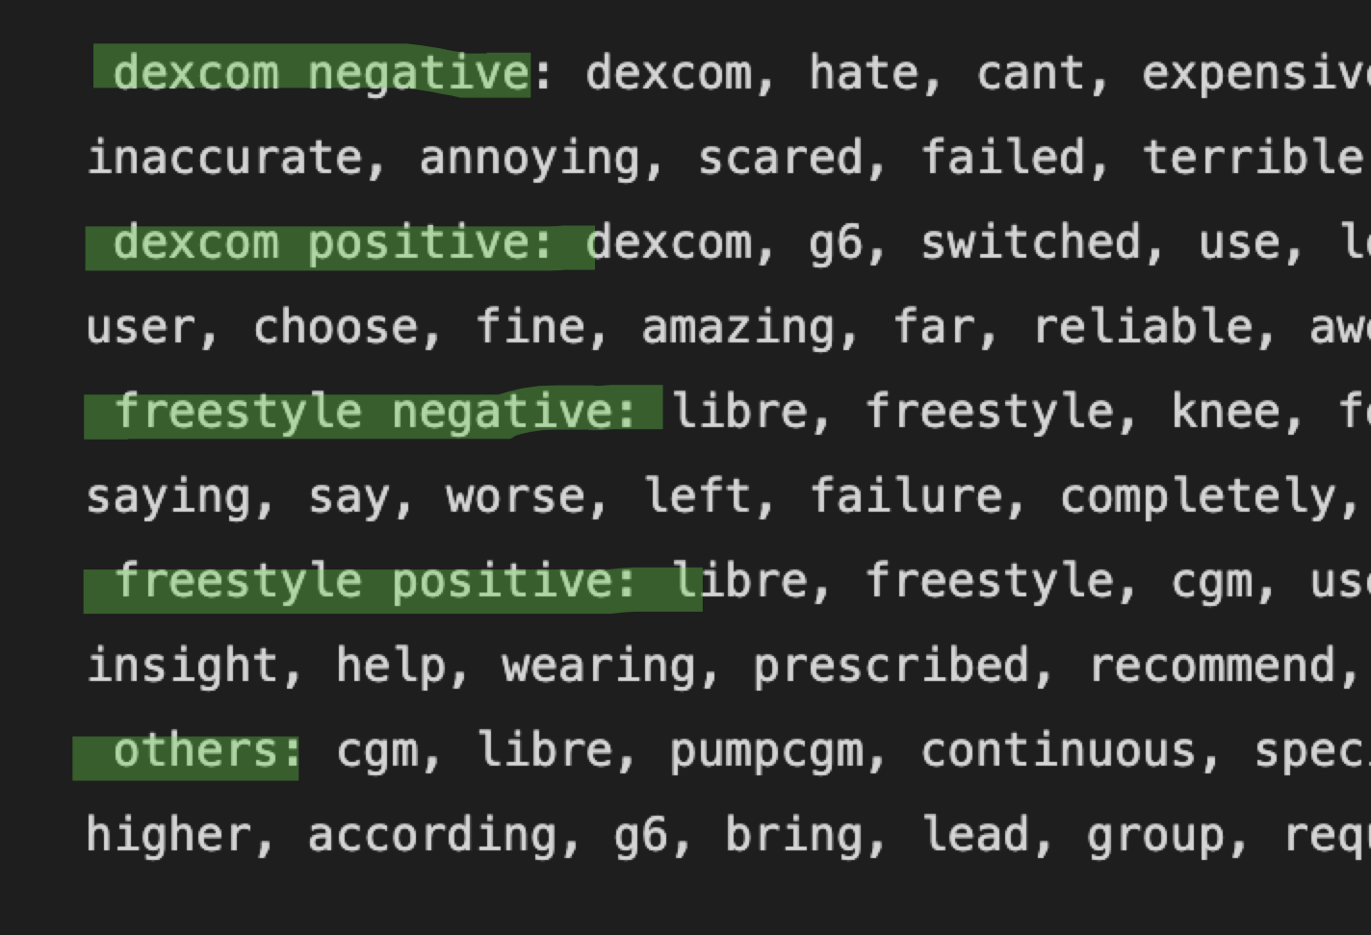
Modelling method for Customers’ Praises and Complaints
Dexcom
Dexcom Positive
FreeStyle Libre
Dexcom Negative
FreeStyle Positive
FreeStyle Negative
Others
1
2
3
Classify customer feedback for each brand
Separate each brand's feedback into distinct sentiment categories.
Use logistic regression to identify key words for each sentiment classification.

Slide 13
PART 3
Questions about Customers
Notes:
juan

Slide 14
Question 1: What are customers expectation?

Slide 15
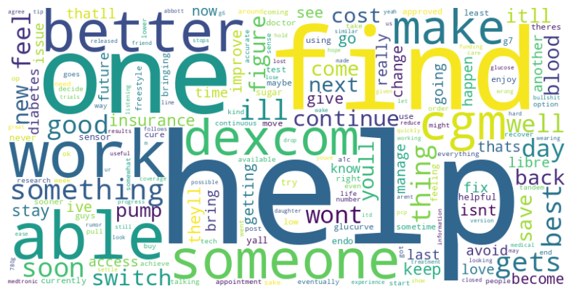
Patient Expectation - To seek help and improve life
“...The best i can hope for now is to keep my bloodsugar in check at ALL TIMES…”
“...Hope you are doing better, and congratulations on the dexcom!...”
“I'm hoping something that just works and doesn't require loads of different bits”
Notes:
4 grams /8 grams patients express their expectations many words after they say ‘expect/could be/anticipate’.

Slide 16
Question 2: What are customer knowledge gap?

Slide 17
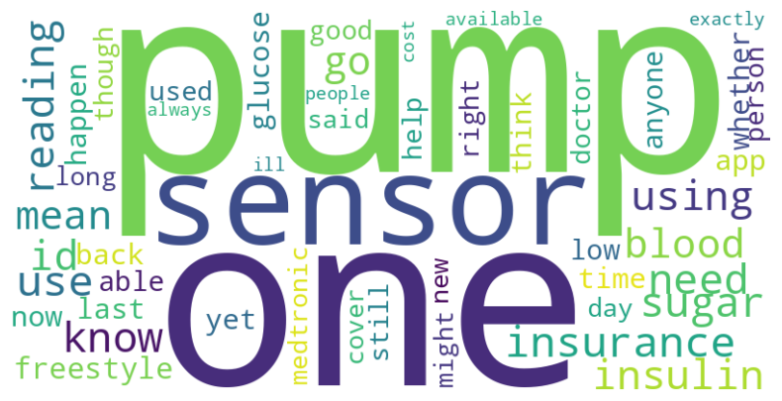
Customer Knowledge Gaps - Application & Pump
“Anyone use a cgm with insulin pens instead of a pump?”
“Applying CGM and/or pump to areas with tattoos.”
“Best Insulin pump?”
“Dexcom G6 compatible pump? (EUROPE)”
“What Pump and CGM are you using? I am looking to switch to a pump that communicates with the CGM.”
Notes:
From text, title also shows emphasis on pump. But also problems with insurance, sensors etc.

Slide 18
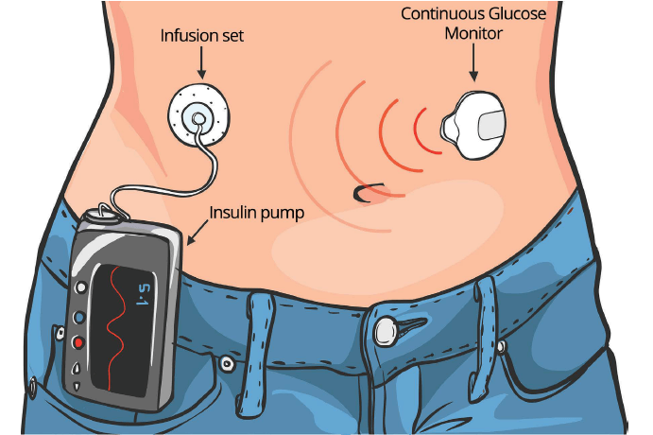
Integrated Systems
Notes:
Reason why so many mentions in pump for social media post about CGM is they are usually used in combination. The CGM will monitor, while a insulin pump will deliver based on CGM readings. And it works like an artificial pancreas.
So, from what we saw from social listenings, CGM companies should provide more information or assistance to address pumps related questions. And for those who are not aware of such integrated systems, it’s time to fill the knowledge gap.
Another thing is the technology is relatively new and somewhat complex, and the social listening only includes opinions from those who use those platforms in regular basis. So a channel to reach an older audience (as they also have a higher diabetes rate) is important.

Slide 19
PART 4
Questions about the two brands

Slide 20
Question 3: What are the general sentiments of the customers of Dexcom and Freestyle Libre?

Slide 21
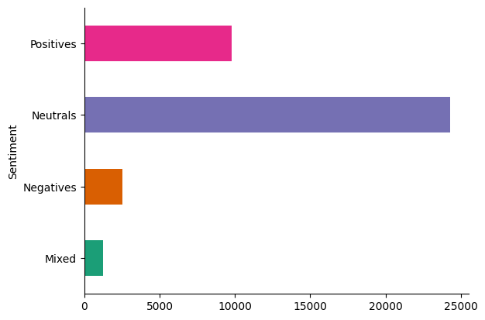
Sentiment
Notes:
Sentiment surrounding CGMs are generally neutral,
skylar

Slide 22
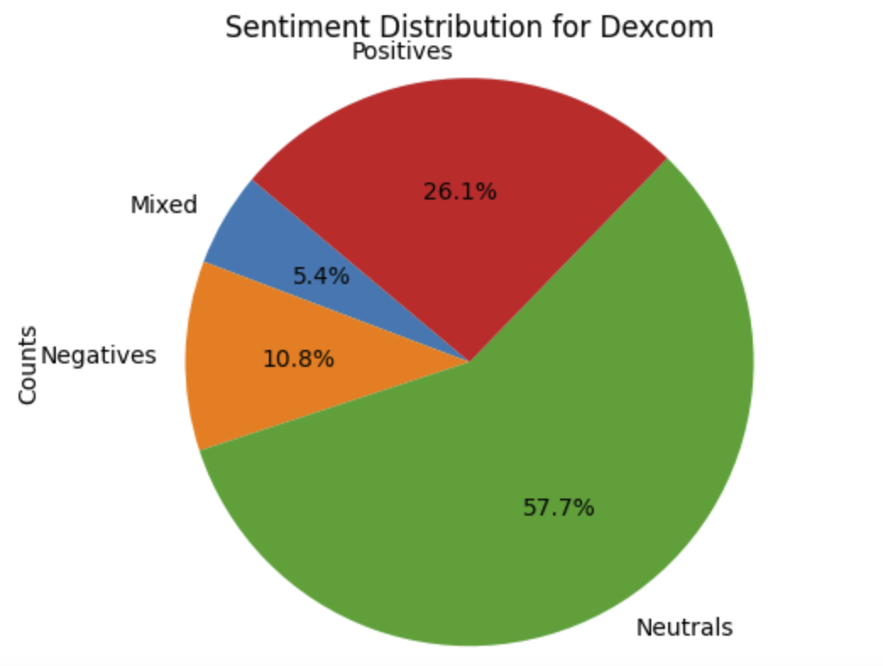
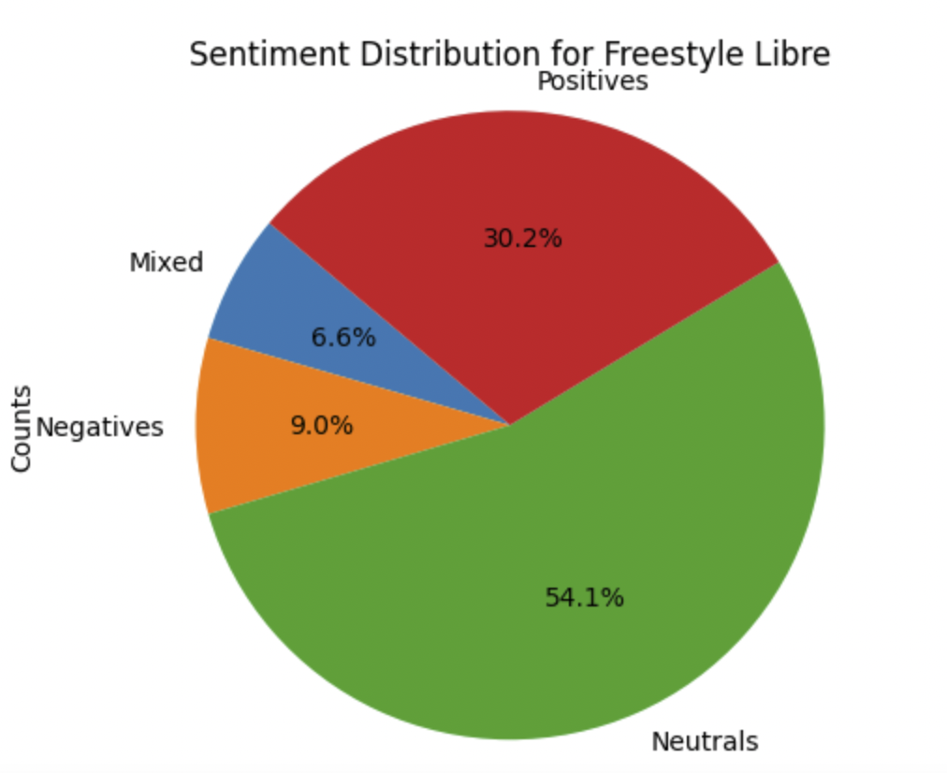
Sentiment Analysis - General

Slide 23
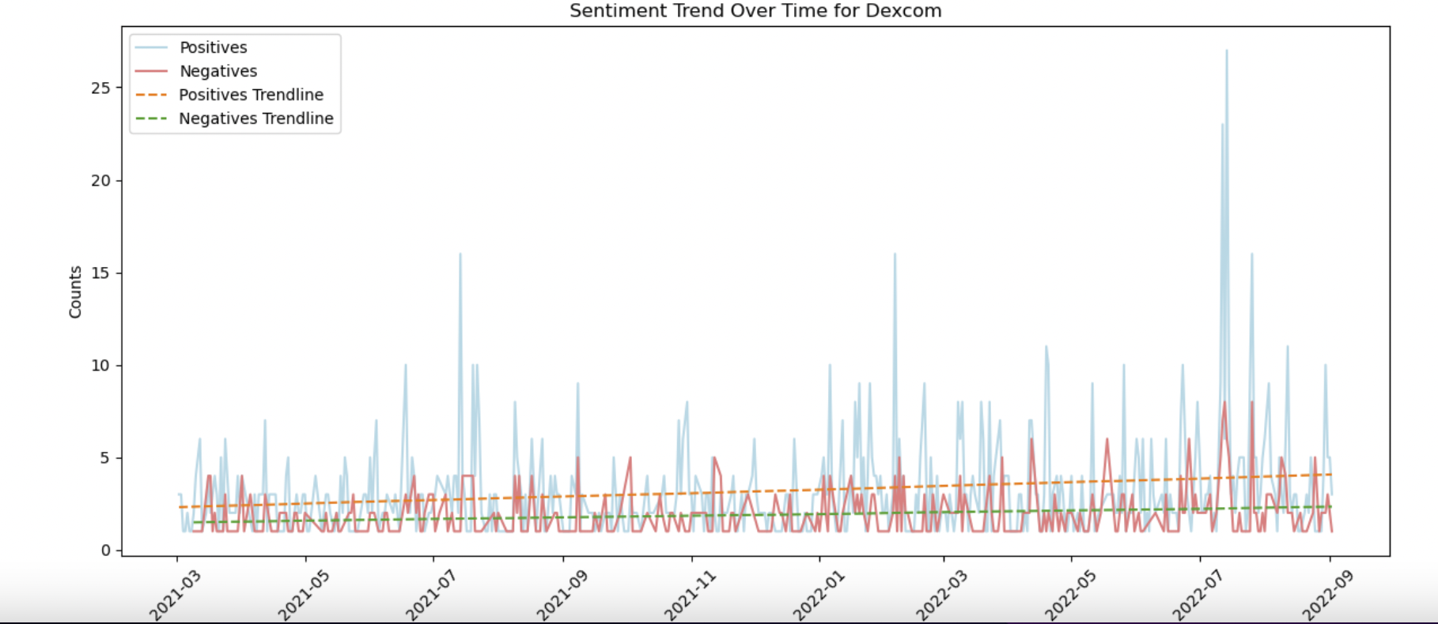
Sentiment Analysis - Tendency
The Positive comments of Dexcom has slight tendency of rising

Slide 24
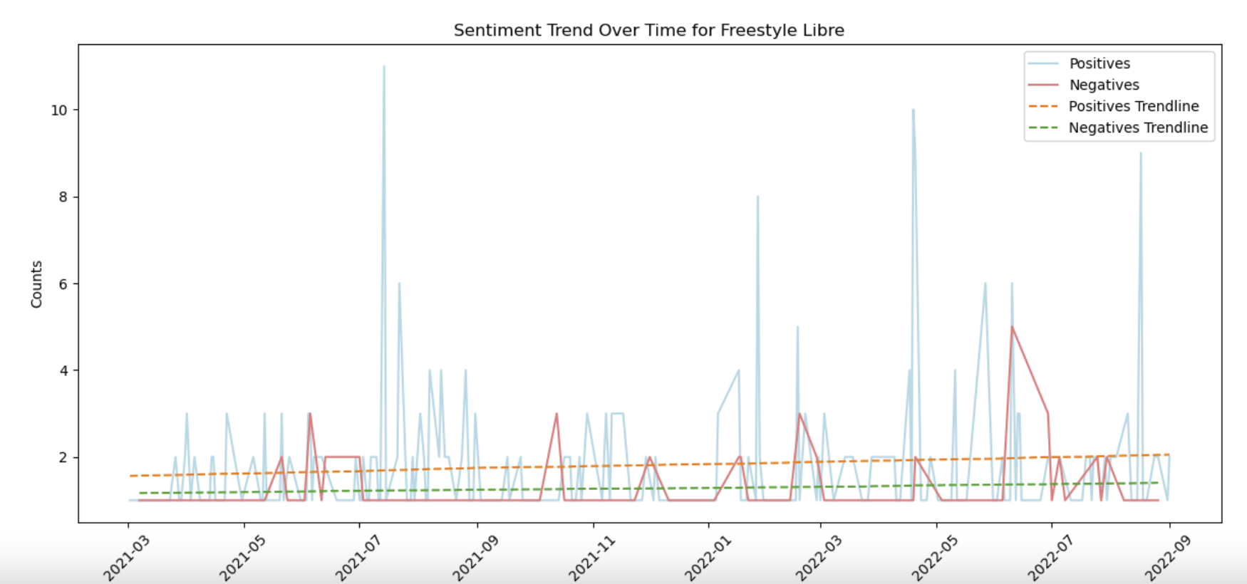
Sentiment Analysis - Tendency
The positive comments of Freestyle Libre is increasing more obviously

Slide 25
Question 4: What are the praises and complaints of
these two brands?

Slide 26
Top words for each classification
dexcom negative: dexcom, hate, cant, expensive, painful, suck, dexcoms, trouble, afford, bc, complication, connection, xdrip, wont, battery, away, hasnt, inaccurate, annoying, scared, failed, terrible, bad, receiver, hurt, yet, baby, kinda, transmitter, app
dexcom positive: dexcom, g6, switched, use, love, switching, recommend, combo, diagnosed, wear, best, wait, easier, free, warranty, prefer, helped, switch, user, choose, fine, amazing, far, reliable, awesome, dexcoms, guardian, tandem, omnipod, iq
freestyle negative: libre, freestyle, knee, feature, there, skin, sensor, yesterday, accurate, problem, never, would, frustrating, doesnt, reader, telling, saying, say, worse, left, failure, completely, dex, hold, 50, device, alarm, anyone, na, expensive
freestyle positive: libre, freestyle, cgm, use, glucose, love, exercise, 14, great, track, spike, phone, hba1c, wear, food, needle, ate, canada, month, insight, help, wearing, prescribed, recommend, condition, fasting, monitor, 80, hi, iphone
others: cgm, libre, pumpcgm, continuous, specific, source, med, whether, must, rate, monitor, despite, medicare, moving, diet, running, pump, uk, insulin, higher, according, g6, bring, lead, group, required, top, clarity, lost, cover

Slide 27
Praises and complaints between the two brands
 | Positive | Negative
Dexcom | Tslim Free | Expensive Painful Complication
Freestyle Libre | Exercise Track | Skin (In)Accurate

Slide 28
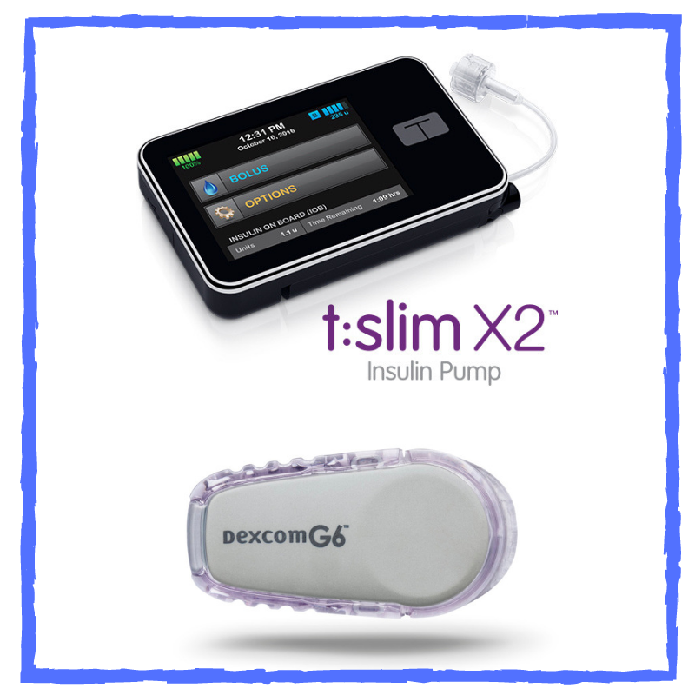
Dexcom:
Praise - Tslim
the dexcom/tslim with control iq was my best combo and there are more improvements coming later this year for this equipment.
the dexcom/tslim combo is far superior. i'm on the dexcom for a month and a half and the pump since friday and it really is life changing.

Slide 29
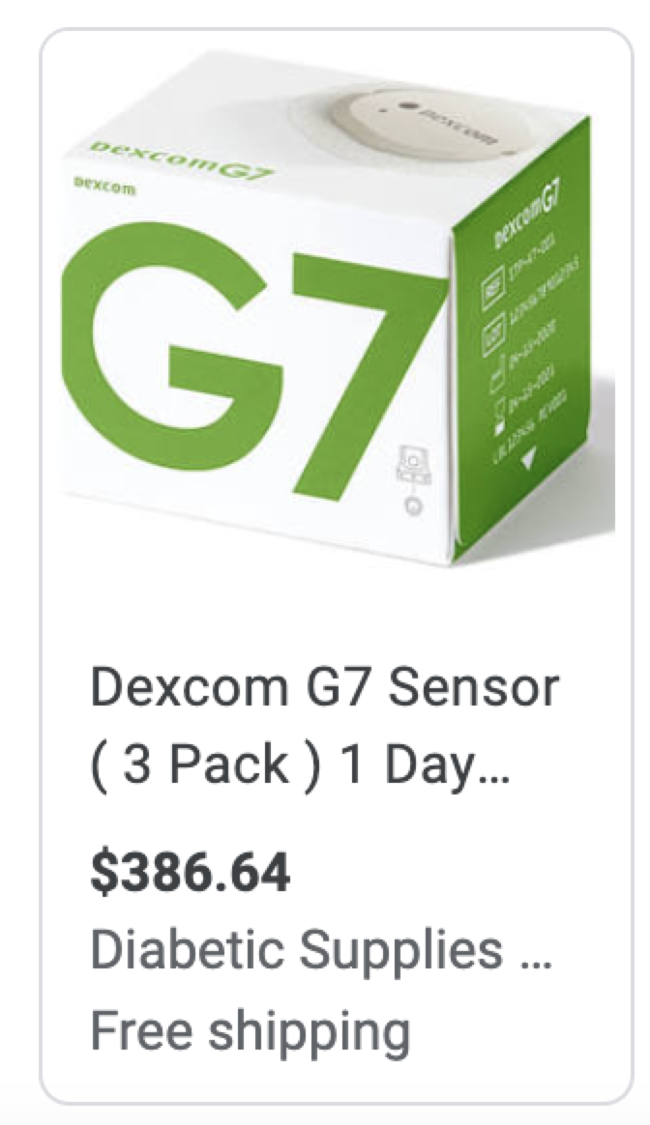
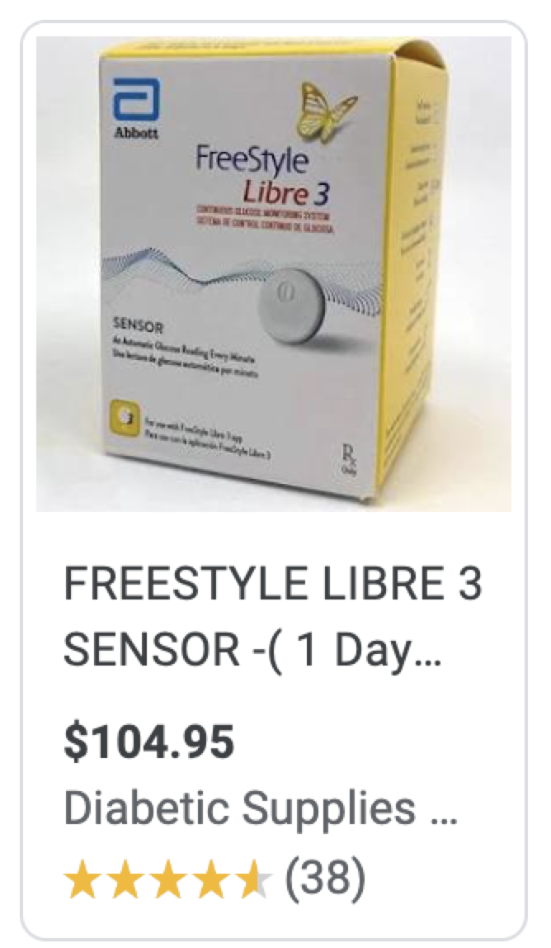
Dexcom:
Complaint - Expensive
but until a company rep calls and helps me figure this crap out, i’m not going near it. for me, the dexcom g6 was an expensive failure.
i can't afford to buy dexcom they are literally half of the minimal wage in my country.

Slide 30
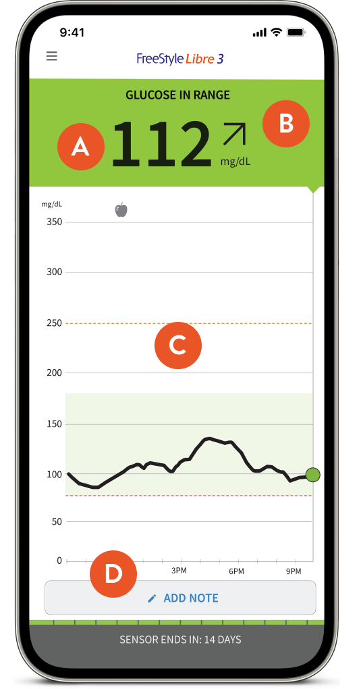
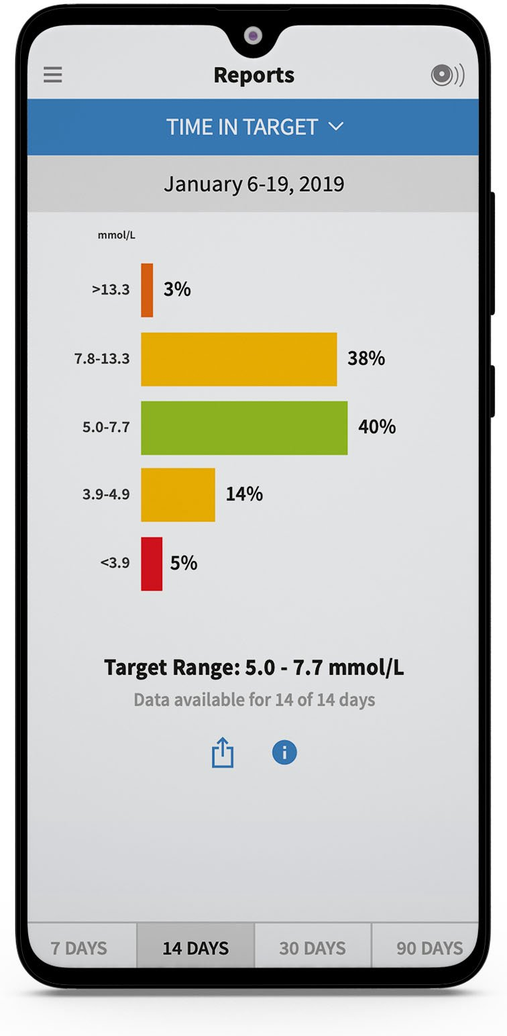
Freestyle Libre:
Praise - Track
it’s worth the tracking to feel good! it’s so nice to just scan that little beauty with my iphone instead of pricking my fingers 5+ times a day. my fingers thank me!!
i use freestyle libre with nightrider to manage my glucose level. it helps me to track glucose on watch with alarms when the glucose is out of range. it is such an amazing tool.

Slide 31
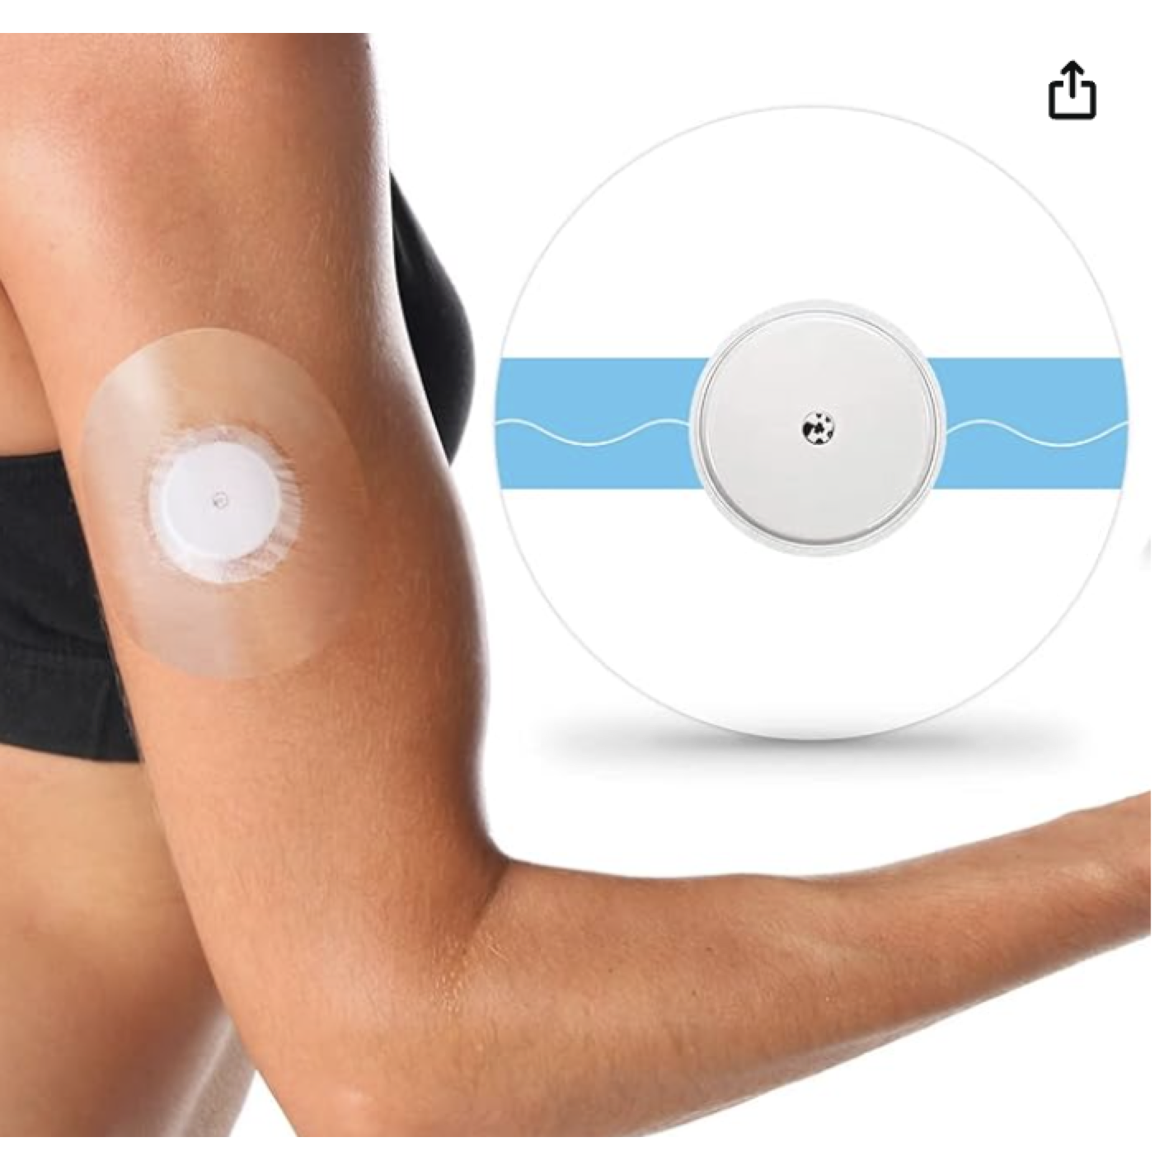
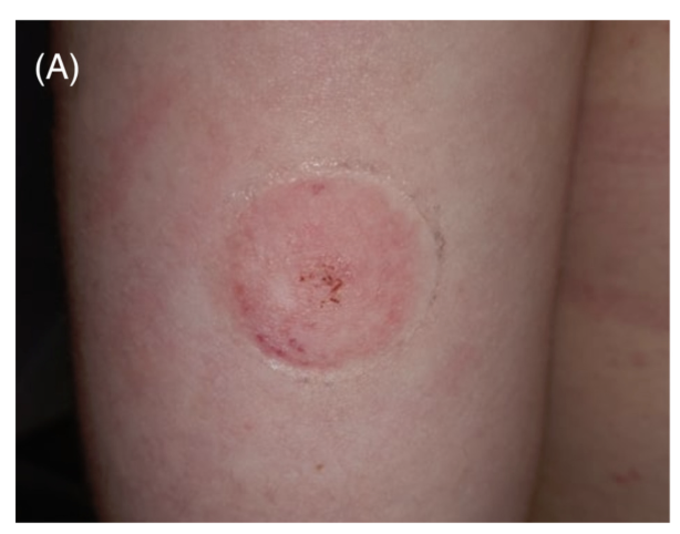
Freestyle Libre:
Complaint - Skin
i used to have this experience with the libre. idk if i hit close to a nerve but sometimes when i’d insert, it’d be sore, like surprisingly so for such a small needle.
my freestyle libre sensors have been causing incredible rashes. for about two years now i've carefully placed a physical bandage between the sensor and my skin, as well as over the sensor to hold it there for two weeks. does anyone have a better solution than this?

Slide 32
PART 5
Recommendation and
Summary

Slide 33
Summary
The main problem: How can we improve dexcom and freestyle libre with better user experience
expectation
1
An accurate user-friendly affordable glucose tracker
knowledge gap
User guidance on CGM and Insulin pump, CGM version
Customer side
Sentiment Overall positive and reliable
Dexcom: Positive - Combo (CGM & Pump) // Negative - Expensive
Freestyle: Positive - Convenient Tracking // Negative - rashes on the skin
feedback

Slide 34
Recommendations for Next steps
Develop Additional Pairings:
Diabetes Management Tools
smartphone
Affordability:
Create offering payment plans, subsidies/several- time payment plan
Partnering with insurance companies to provide coverage
Improve Device Synergy and Connection:
Advance development to seamlessly connect with additional lifestyle tools, such as NightRider or Peloton.
Develop Skin-Friendly Solutions:
Innovate in creating more skin-friendly sensors
offer additional protective products to prevent skin issues.

